Slide 1
2.3.3 Testing of software structure/architecture (structural testing)

Slide 2

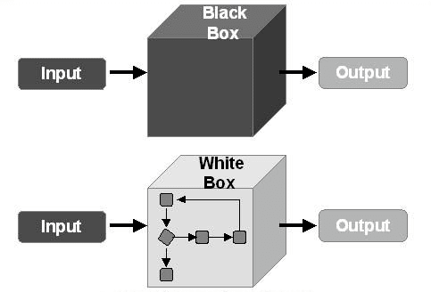
Structural tests are often referred to as "white boxes" or "glass boxes“.
Structural testing is often used as a measure of testing.
It can happen at any level of testing mainly in component testing, integration.

Slide 3

Coverage metrics measure the percentage of executions that have been performed by a test suite. If the coverage is not 100%, then additional tests may need to be written and run to cover the unexecuted parts.
The techniques used for structural testing are white box testing, control flow models commonly used to support structural testing.

Slide 4
2.3.4 Testing related to change (confirmation and regression testing)

Slide 5
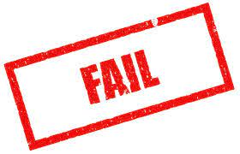




Confirmation testing (re-testing)
01
Test fail
02
Determine the cause
03
The bug is reported
04
New version (fixed bug)
05
Re-testing

Slide 6

Regression testing
Like confirmation testing, regression testing involves the execution of previously executed test cases.
The difference is that for regression testing, the test cases may be true the last time they were executed.
Purpose: verify that modifications in the software or the environment do not cause unintended adverse effects and that the system still meets its requirements.

Slide 7

Regression testing
All the cases in the regression test suite will be executed every time a new version of the software is released and this makes them ideal for automation.
Regression testing is performed when the software changes, due to bug fixes, new functionality. It is also a good idea to enforce them when some aspect of the environment changes.

